Slide 1
Activation Functions

Slide 2
Why do neural networks need activation function?
An activation function is a function that is added into an artificial neural network in order to help the network learn complex patterns in the data. When comparing with a neuron-based model that is in our brains, the activation function is at the end deciding what is to be fired to the next neuron
A neural network without an activation function is essentially just a linear regression model. The activation function does the non-linear transformation to the input making it capable to learn and perform more complex tasks.

Slide 3
Agenda
Binary Step Function
Linear Activation Function
Non-Linear Activation Functions
Sigmoid / Logistic Activation Function
Tanh Function (Hyperbolic Tangent)
ReLU Function
Leaky ReLU Function

Slide 4
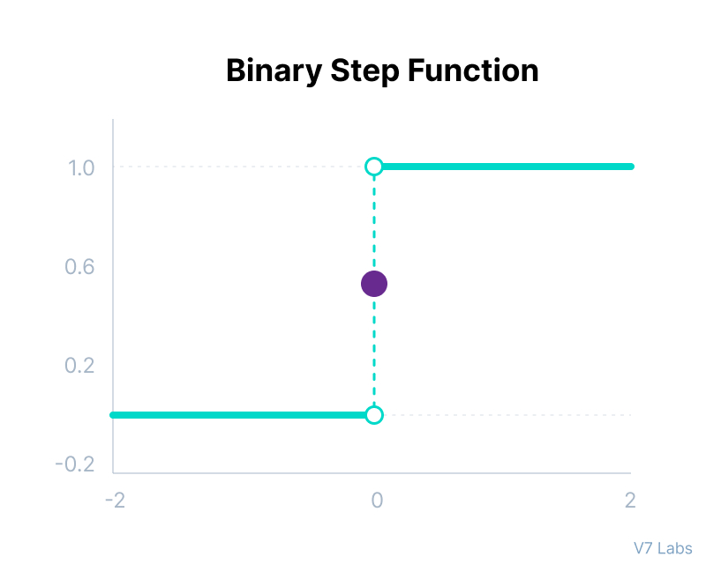
Binary Step Function
Binary step function depends on a threshold value that decides whether a neuron should be activated or not.
The input fed to the activation function is compared to a certain threshold; if the input is greater than it, then the neuron is activated, else it is deactivated, meaning that its output is not passed on to the next hidden layer.

Slide 5
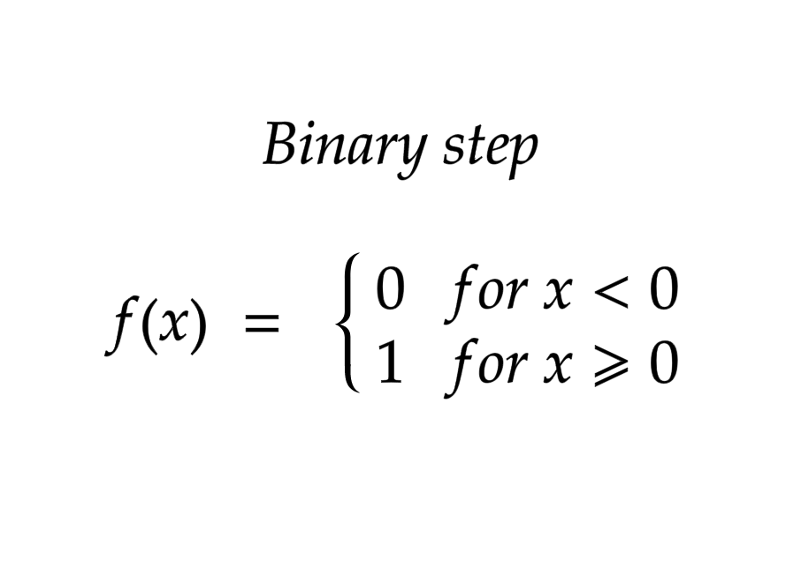
Binary Step Function
Mathematically it can be represented as:
limitations of binary step function:
It cannot provide multi-value outputs—for example, it cannot be used for multi-class classification problems.
The gradient of the step function is zero, which causes a hindrance in the backpropagation process.

Slide 6
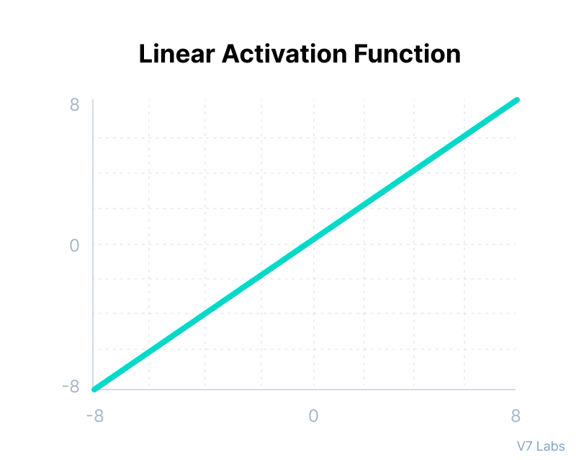
Linear Activation Function
The linear activation function, also known as "no activation," or "identity function" (multiplied x1.0), is where the activation is proportional to the input.
The function doesn't do anything to the weighted sum of the input, it simply spits out the value it was given.

Slide 7
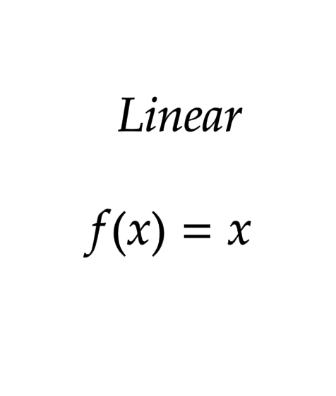
Linear Activation Function
Mathematically it can be represented as:
linear activation function has two major problems :
It’s not possible to use backpropagation as the derivative of the function is a constant and has no relation to the input x.
All layers of the neural network will collapse into one if a linear activation function is used. No matter the number of layers in the neural network, the last layer will still be a linear function of the first layer. So, essentially, a linear activation function turns the neural network into just one layer.

Slide 8
Non-Linear Activation Functions
The linear activation function shown above is simply a linear regression model.
Because of its limited power, this does not allow the model to create complex mappings between the network’s inputs and outputs.
Non-linear activation functions solve the following limitations of linear activation functions:
They allow backpropagation because now the derivative function would be related to the input, and it’s possible to go back and understand which weights in the input neurons can provide a better prediction.
They allow the stacking of multiple layers of neurons as the output would now be a non-linear combination of input passed through multiple layers. Any output can be represented as a functional computation in a neural network.

Slide 9
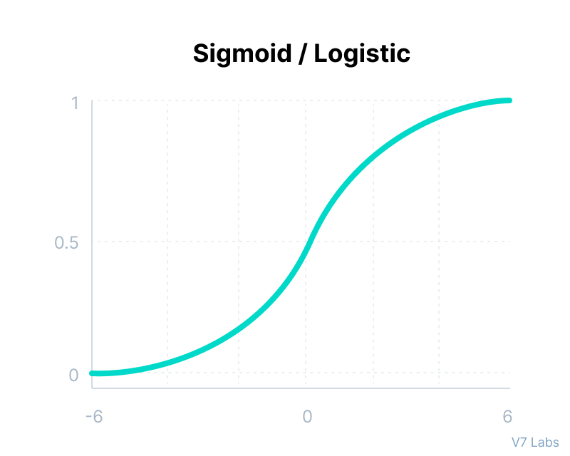
Sigmoid / Logistic Activation Function
This function takes any real value as input and outputs values in the range of 0 to 1.
The larger the input (more positive), the closer the output value will be to 1.0, whereas the smaller the input (more negative), the closer the output will be to 0.0, as shown below.

Slide 10
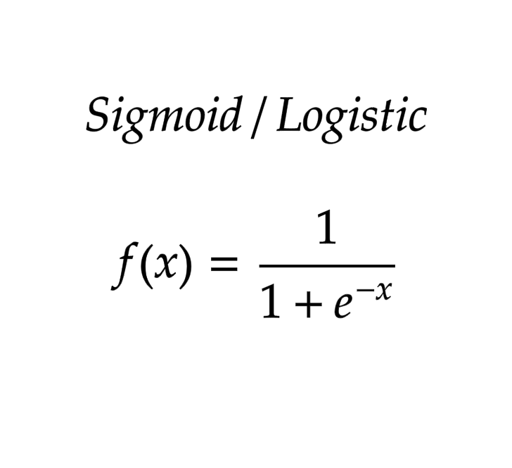
why sigmoid/logistic activation function is one of the most widely used functions:
It is commonly used for models where we have to predict the probability as an output. Since probability of anything exists only between the range of 0 and 1, sigmoid is the right choice because of its range.
The function is differentiable and provides a smooth gradient, i.e., preventing jumps in output values. This is represented by an S-shape of the sigmoid activation function.

Slide 11
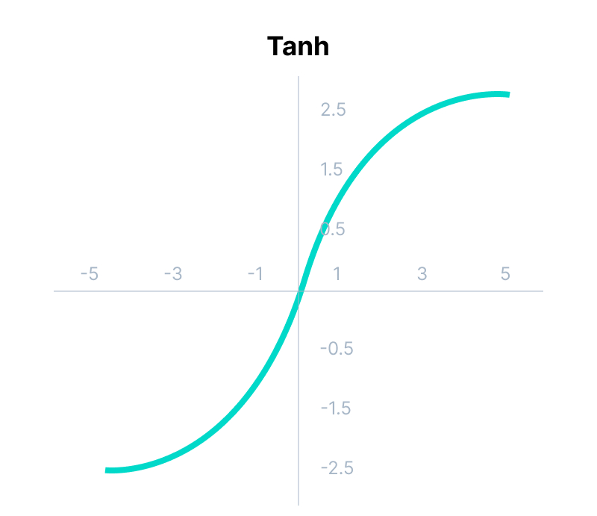
Tanh Function (Hyperbolic Tangent)
Tanh function is very similar to the sigmoid/logistic activation function, and even has the same S-shape with the difference in output range of -1 to 1.
In Tanh, the larger the input (more positive), the closer the output value will be to 1.0, whereas the smaller the input (more negative), the closer the output will be to -1.0.

Slide 12
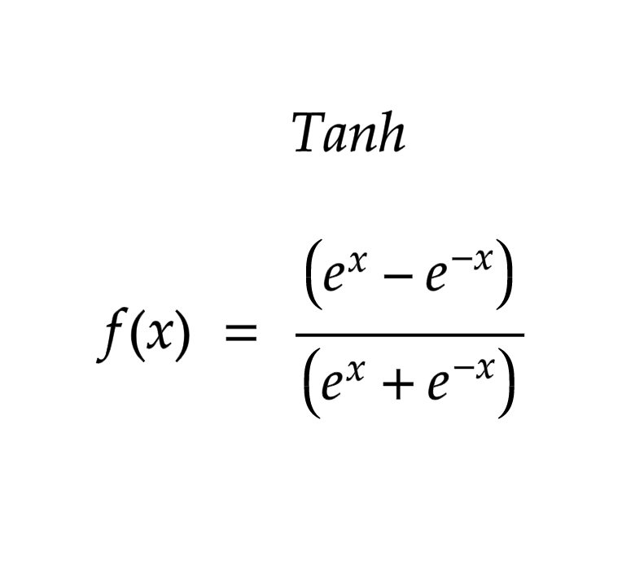
Advantages of using this activation function are:
The output of the tanh activation function is Zero centered; hence we can easily map the output values as strongly negative, neutral, or strongly positive.
Usually used in hidden layers of a neural network as its values lie between -1 to; therefore, the mean for the hidden layer comes out to be 0 or very close to it. It helps in centering the data and makes learning for the next layer much easier.

Slide 13
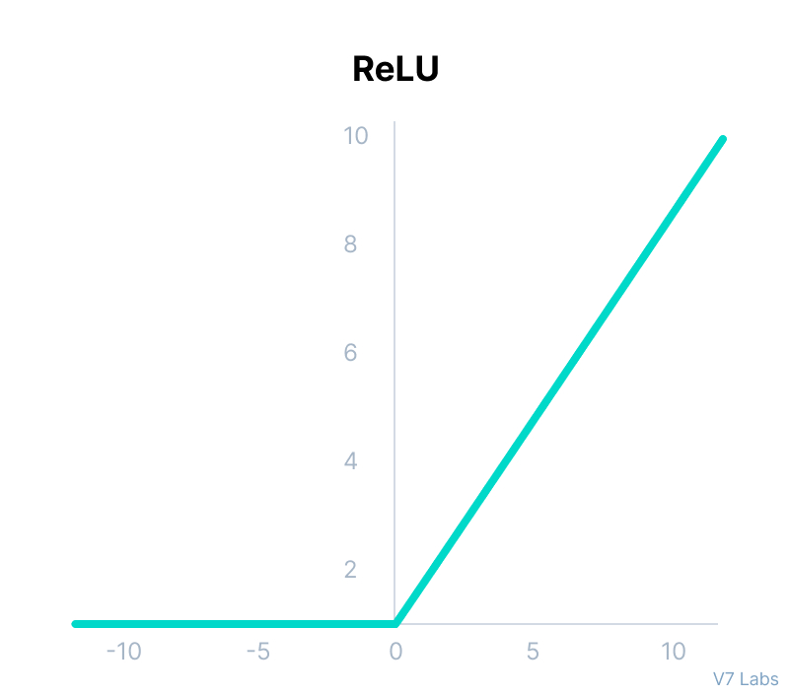
ReLU Function
ReLU stands for Rectified Linear Unit.
Although it gives an impression of a linear function, ReLU has a derivative function and allows for backpropagation while simultaneously making it computationally efficient.
The main catch here is that the ReLU function does not activate all the neurons at the same time.
The neurons will only be deactivated if the output of the linear transformation is less than 0.

Slide 14
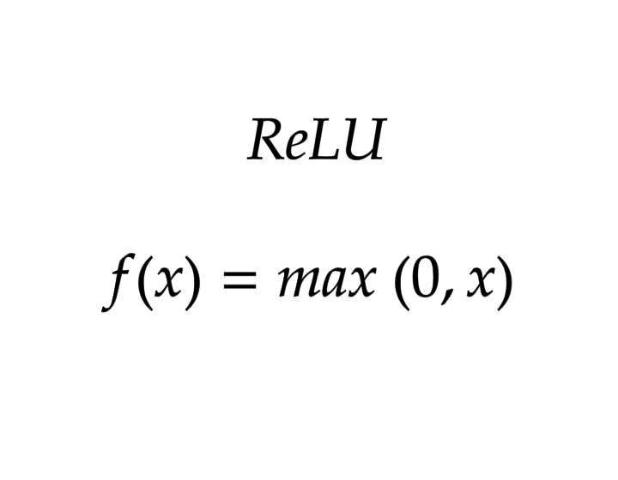
The advantages of using ReLU as an activation function are as follows:
Since only a certain number of neurons are activated, the ReLU function is far more computationally efficient when compared to the sigmoid and tanh functions.
ReLU accelerates the convergence of gradient descent towards the global minimum of the loss function due to its linear, non-saturating property.

Slide 15
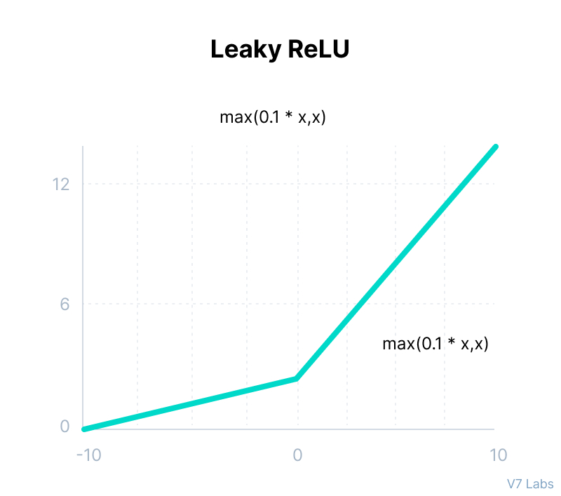
Leaky ReLU Function
Leaky ReLU is an improved version of ReLU function to solve the Dying ReLU problem as it has a small positive slope in the negative area.

Slide 16
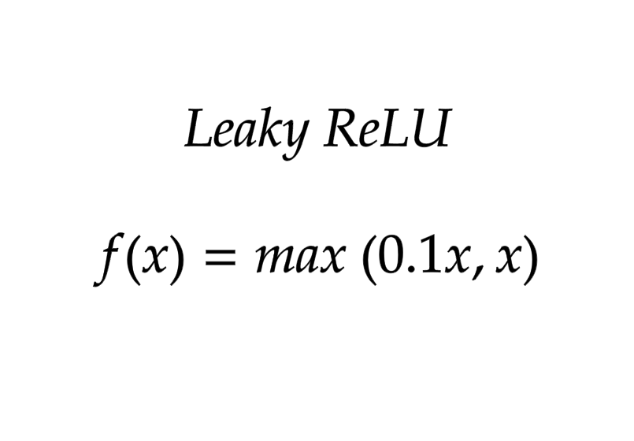
The advantages of Leaky ReLU are same as that of ReLU, in addition to the fact that it does enable backpropagation, even for negative input values.
By making this minor modification for negative input values, the gradient of the left side of the graph comes out to be a non-zero value. Therefore, we would no longer encounter dead neurons in that region.

Slide 17
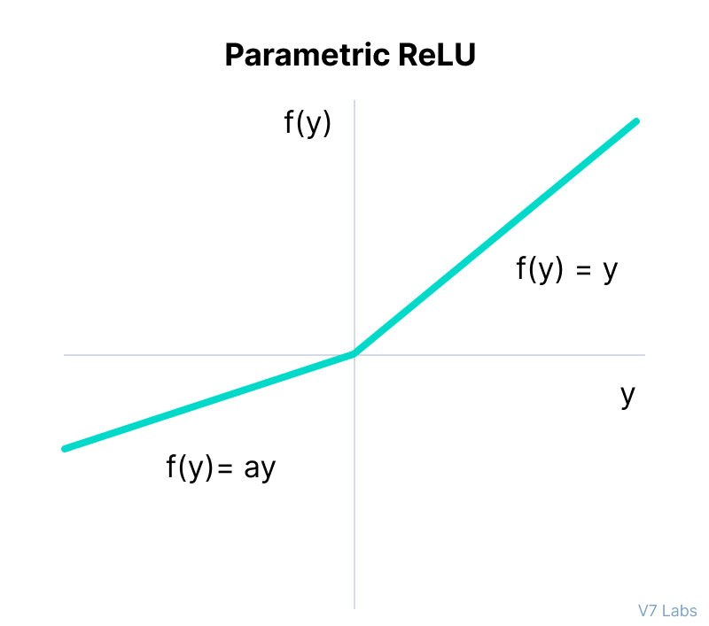
Parametric ReLU Function
Parametric ReLU is another variant of ReLU that aims to solve the problem of gradient’s becoming zero for the left half of the axis.
This function provides the slope of the negative part of the function as an argument a. By performing backpropagation, the most appropriate value of a is learnt.

Slide 18
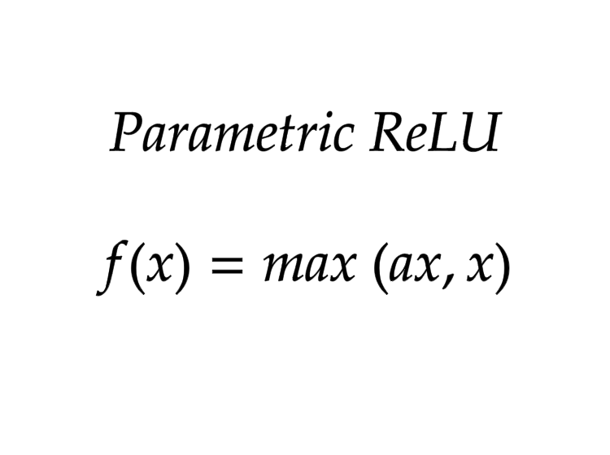
Where "a" is the slope parameter for negative values.
The parameterized ReLU function is used when the leaky ReLU function still fails at solving the problem of dead neurons, and the relevant information is not successfully passed to the next layer.
This function’s limitation is that it may perform differently for different problems depending upon the value of slope parameter a.

Slide 19
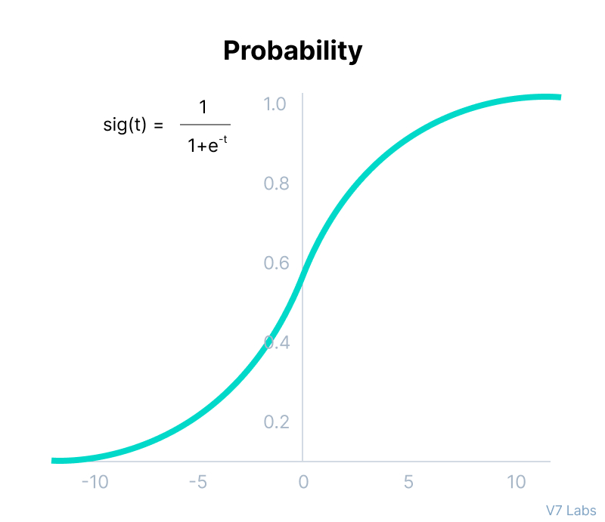
Softmax Function
the Softmax function is described as a combination of multiple sigmoids.
It calculates the relative probabilities. Similar to the sigmoid/logistic activation function, the SoftMax function returns the probability of each class.
It is most commonly used as an activation function for the last layer of the neural network in the case of multi-class classification.

Slide 20
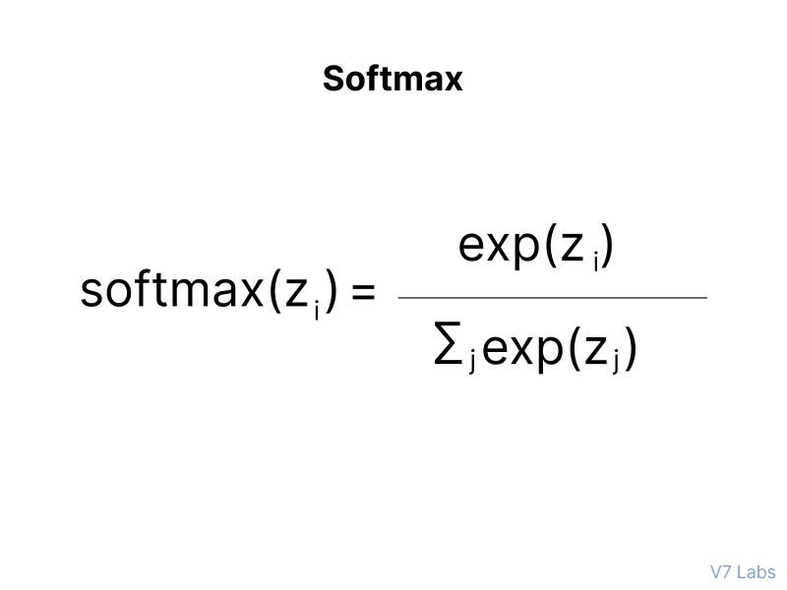
simple example together.
Assume that you have three classes, meaning that there would be three neurons in the output layer. Now, suppose that your output from the neurons is [1.8, 0.9, 0.68].
Applying the softmax function over these values to give a probabilistic view will result in the following outcome: [0.58, 0.23, 0.19].
The function returns 1 for the largest probability index while it returns 0 for the other two array indexes. Here, giving full weight to index 0 and no weight to index 1 and index 2. So the output would be the class corresponding to the 1st neuron(index 0) out of three.

Slide 21
Thank U

